Slide 1
Investigation introduction
Have you got your sheet in front of you?
Highlight the key information on the sheet.

Slide 2
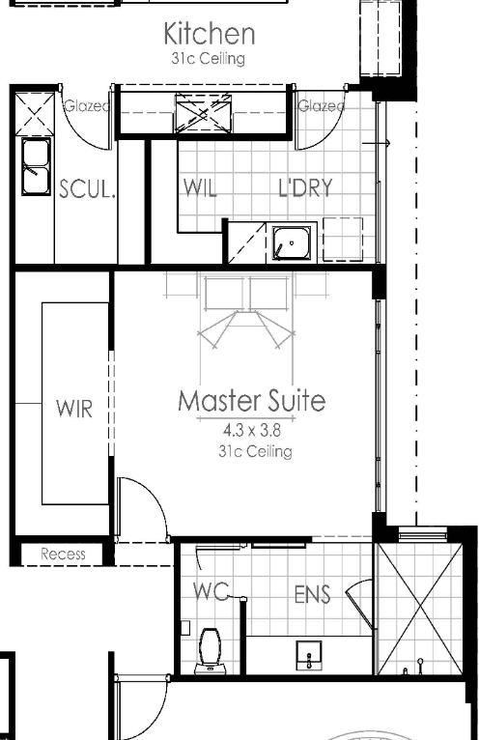
What do you notice in this snapshot?
What annotations are there?
What symbols are there?
How have they represented different floors?
How do you know how big the room is?
What is the difference between thick and thin lines?
Do you think this is a good house plan?
How do you think you would start your report?
Where can you get more information on house designs?

Slide 3
What you need to submit.
There needs to be a neatly presented report, including a house design, costing, and any other relevant information that could be used by a builder.

